Slide 1

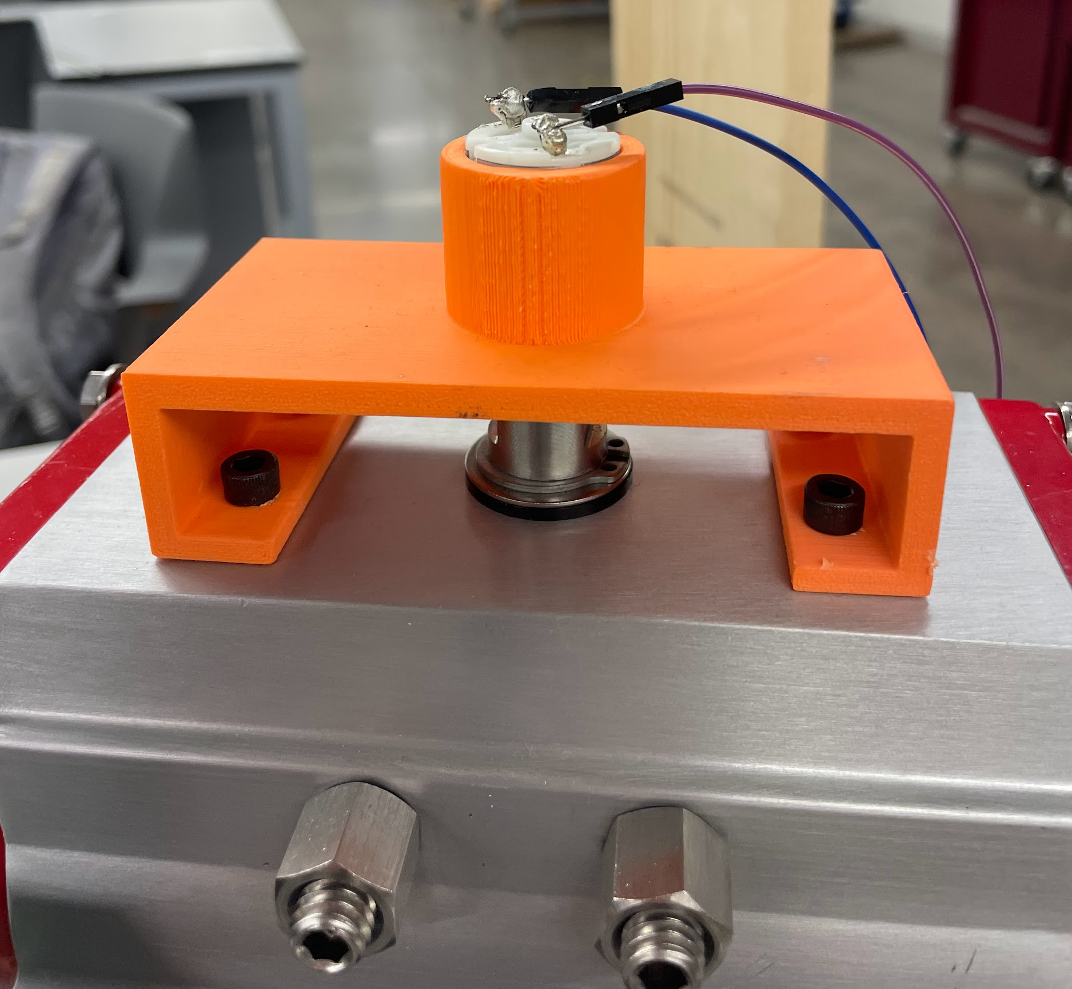
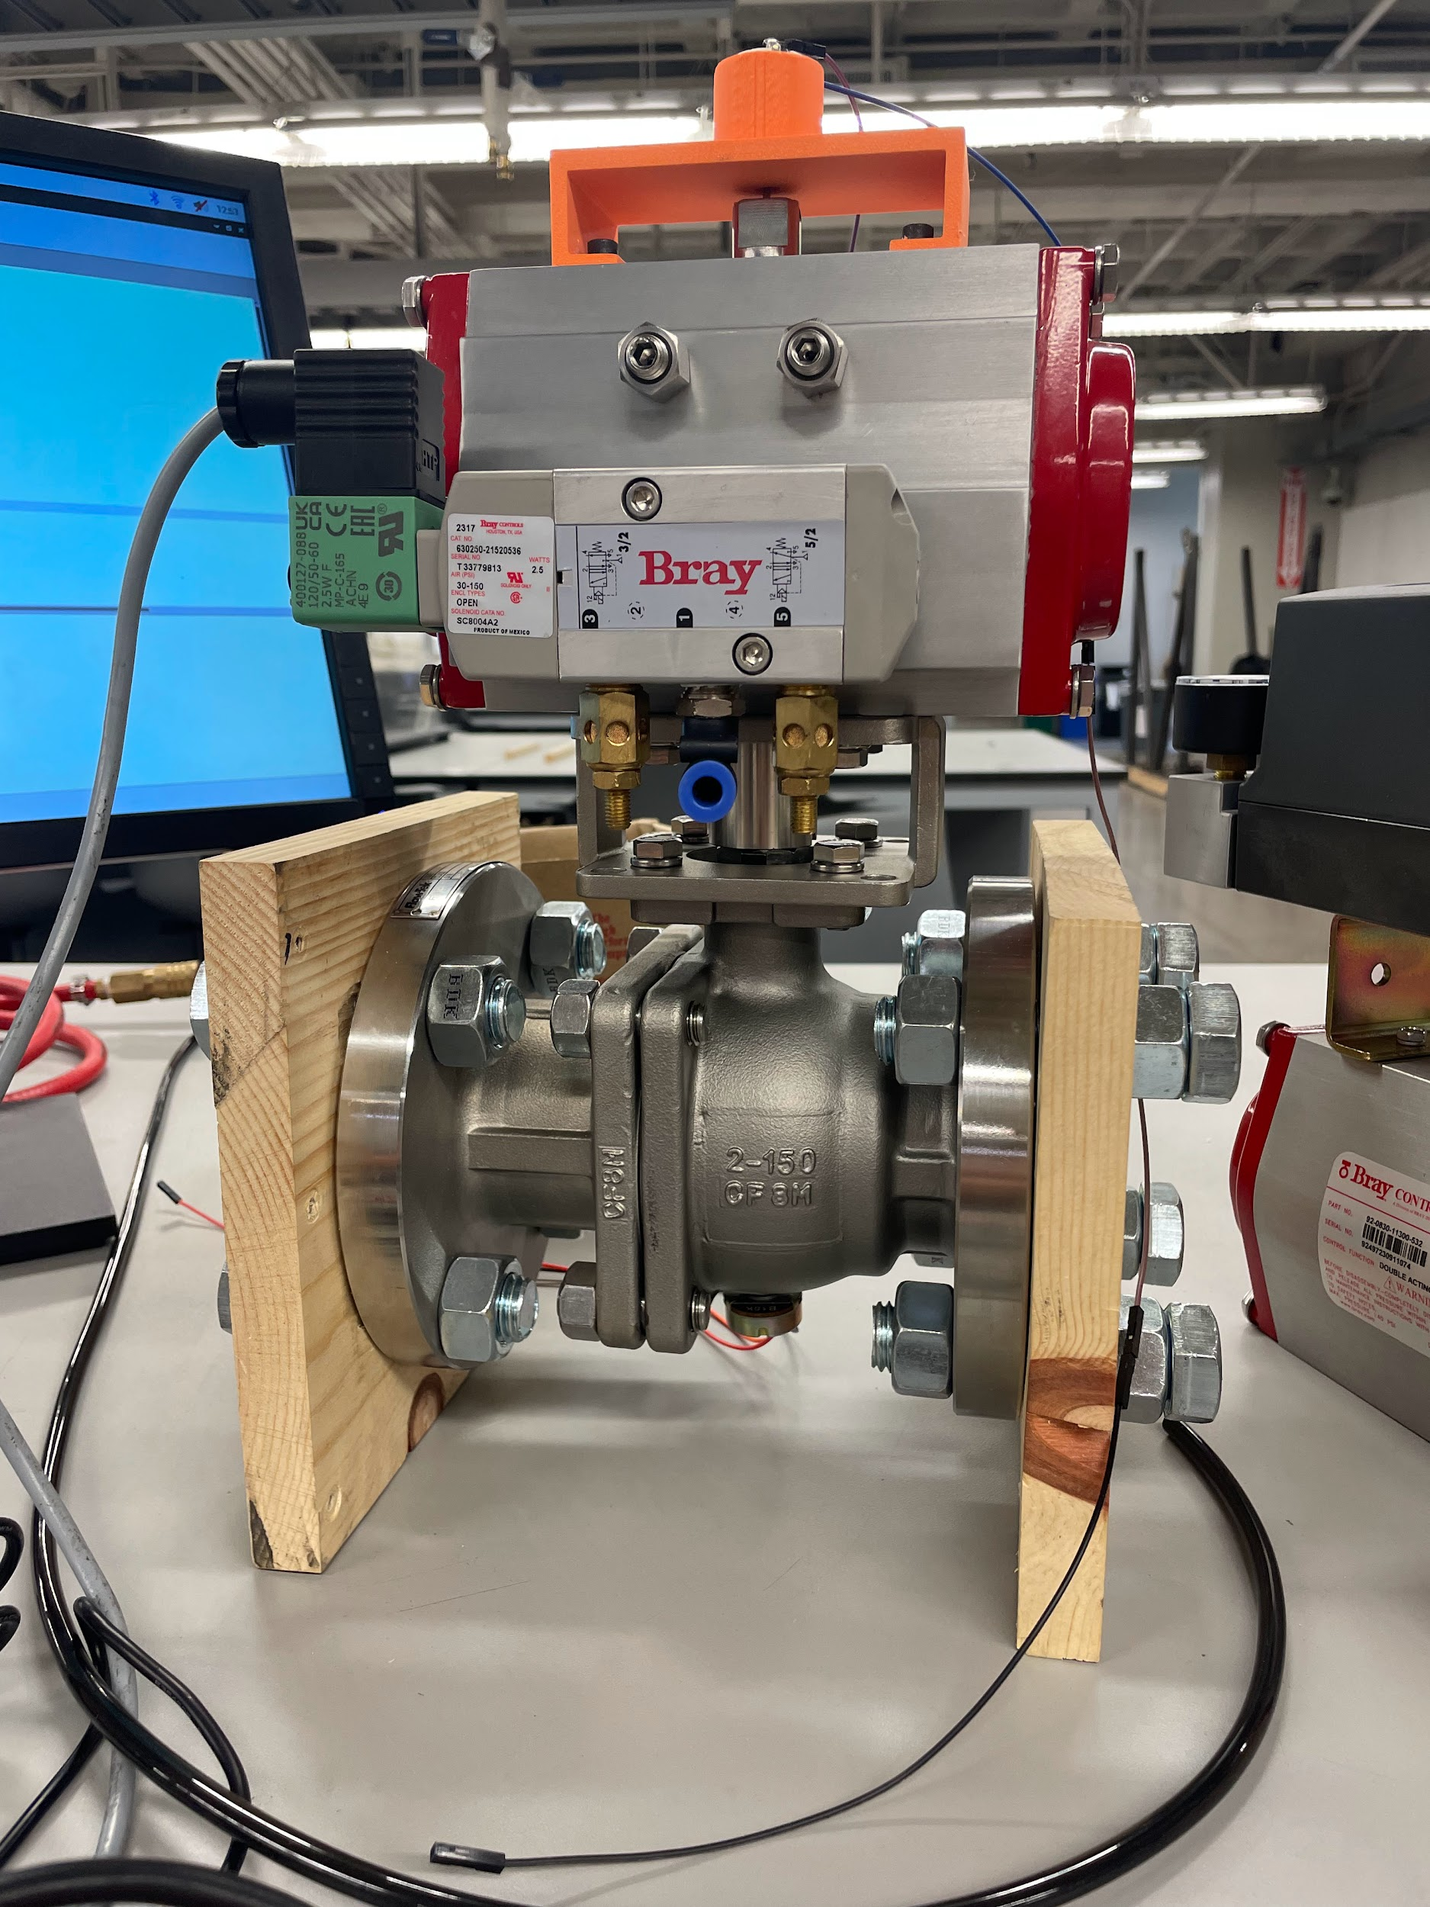
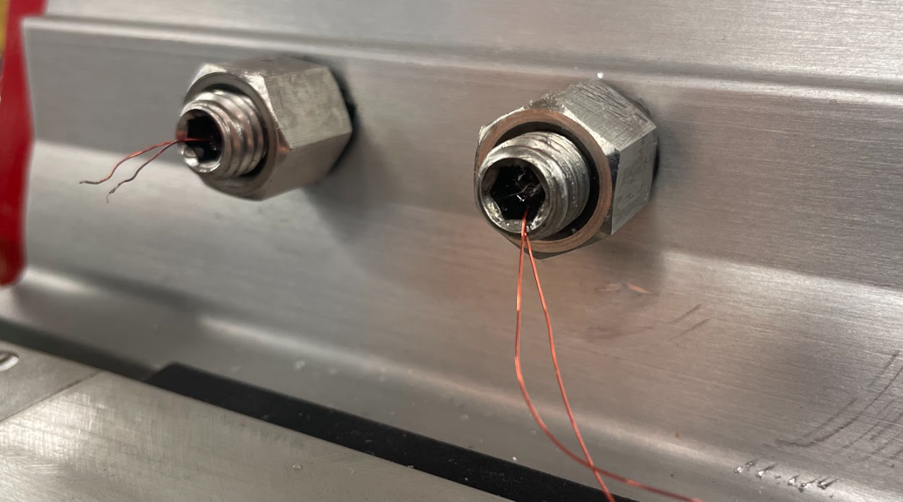
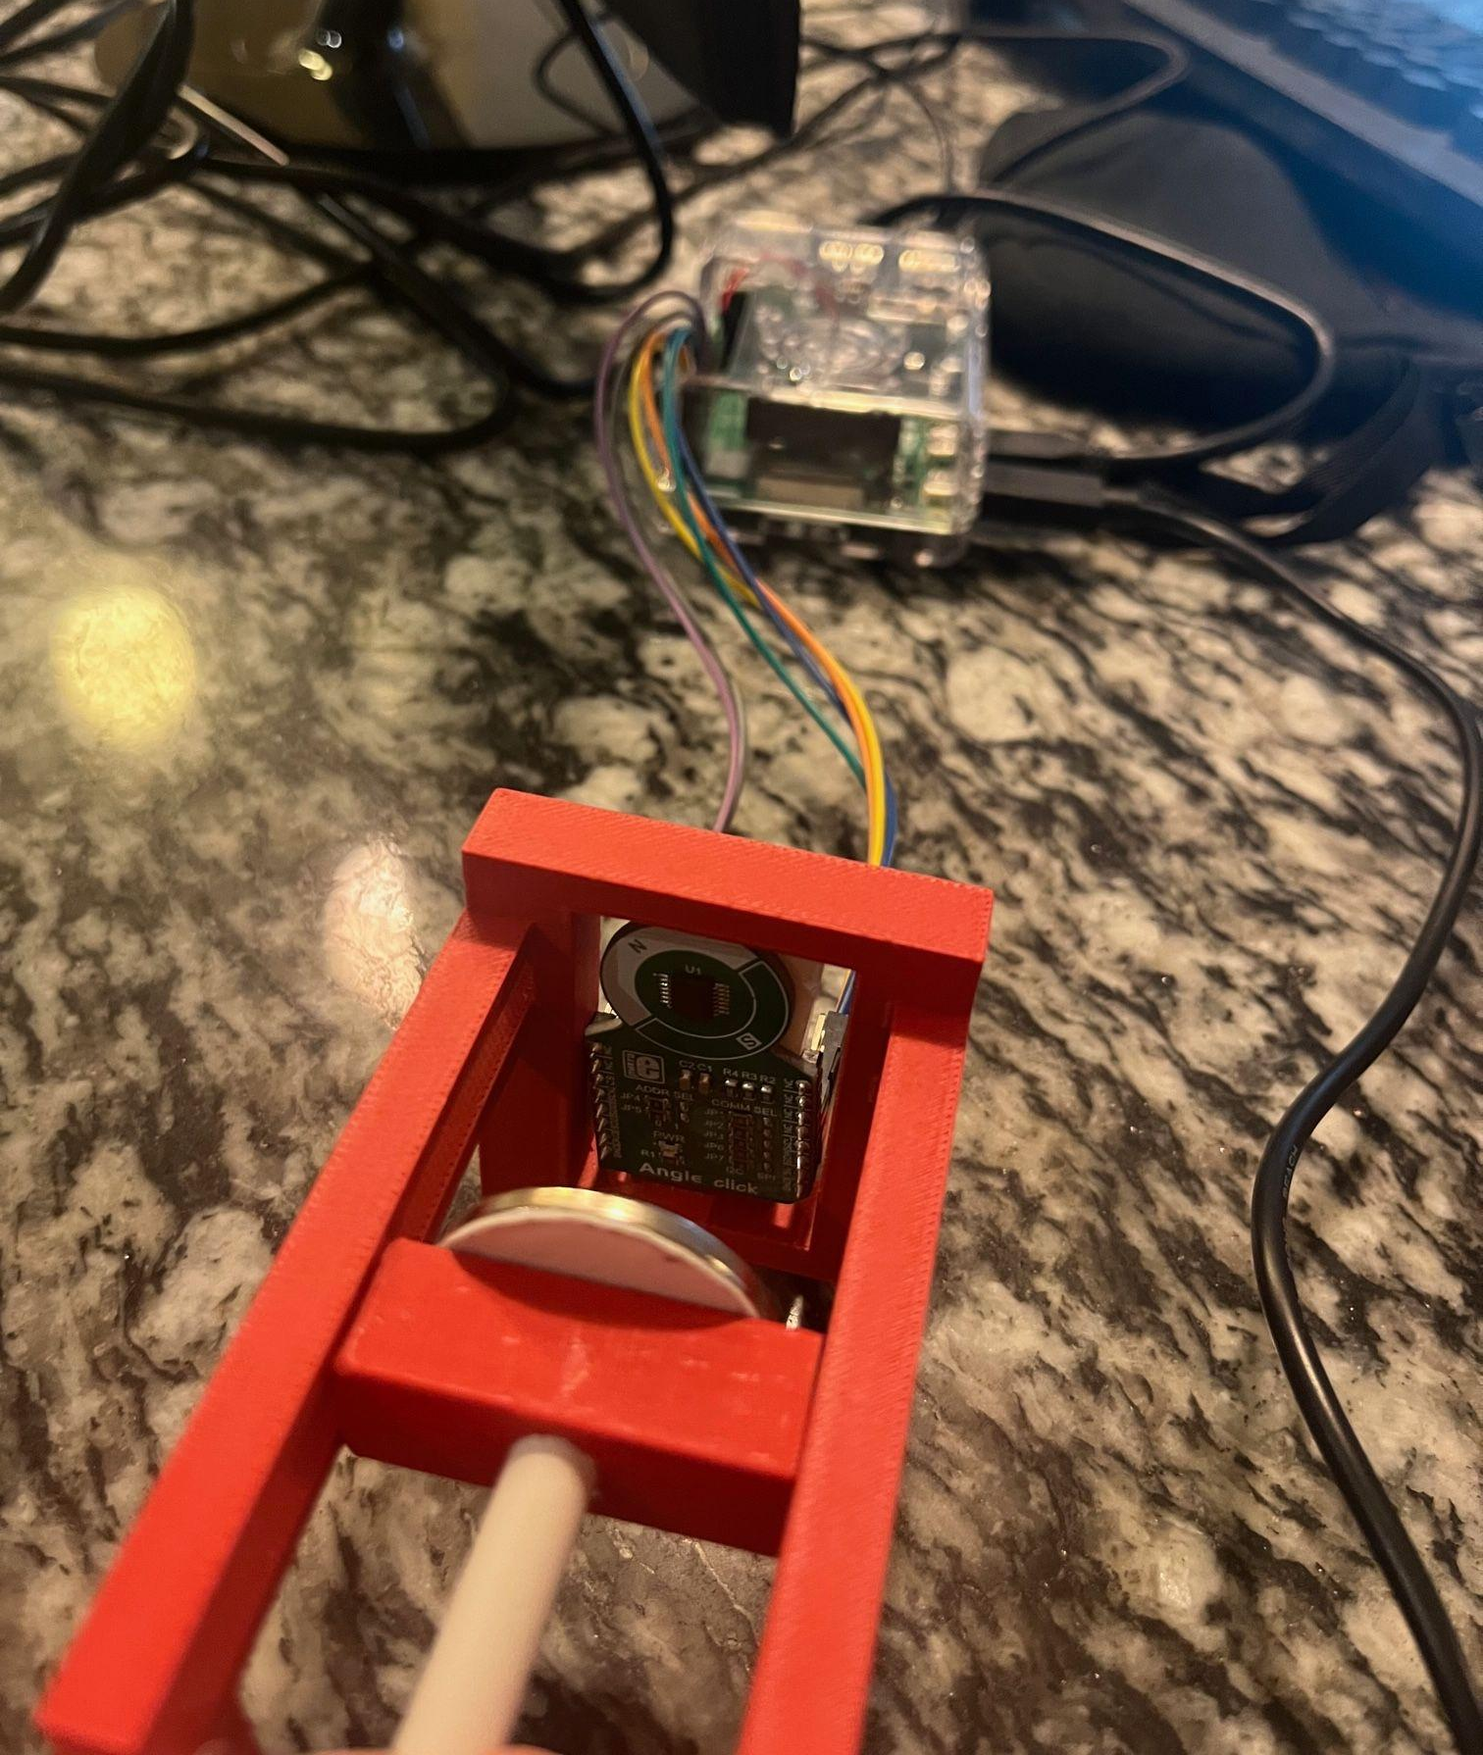
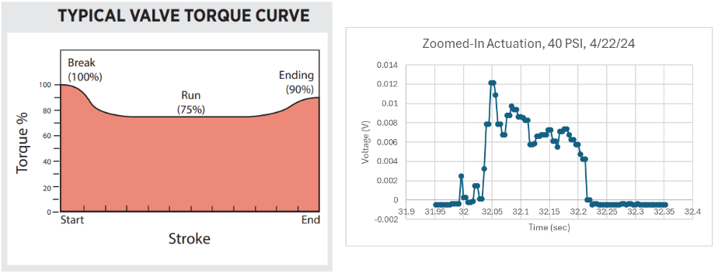
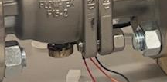
Bray International: Embedded Valve and Actuator Sensors
Two Main Project Goals:
Determining true valve position, independent of an actuator.
Determining actuator output torque, independent of a valve.
Solutions:
Position: Potentiometer, Hall effect sensor
Torque: motor back emf, cylindrical strain gauge
Avery Haynes, Locke Lehmann, Travis Carlson, Cody Sims, Zachary Walker, Michael Hager

Slide 2
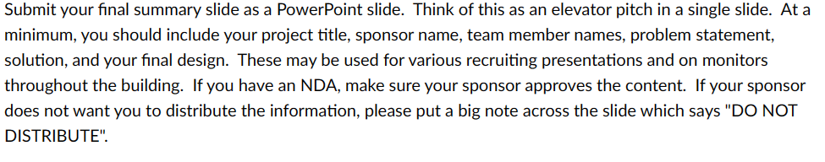
only make one slide

